Slide 1
Difference b/w JDK, JRE, JIT, JVM, Class File Format
Maharaja Agrasen Institute of Technology
ETCS 307
Java Programming
Lecture 3

Slide 2
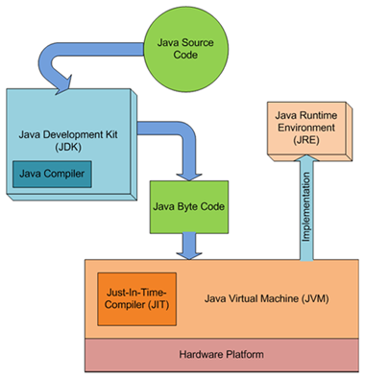
Difference between JDK/JRE/JVM/JIT
JVM: Java Virtual Machine (JVM) is an abstract computing machine. Java programs are written against the JVM specification. JVM is specific for OS platform and they translate the Java instructions to the underlying platform specific instructions and execute them. JVM enables the Java programs to be platform independent.
JRE: Java Runtime Environment (JRE) is an implementation of the JVM and Java API.
JDK: Java Development Kit (JDK) contains JRE along with various development tools like Java libraries, Java source compilers, Java debuggers, bundling and deployment tools.

Slide 3
Difference between JDK/JRE/JVM/JIT
JVM becomes an instance of JRE at runtime of a java program. It is widely known as a runtime interpreter. The Java virtual machine (JVM) is the cornerstone on top of which the Java technology is built upon. It is the component of the Java technology responsible for its hardware and platform independence. JVM largely helps in the abstraction of inner implementation from the programmers who make use of libraries for their programmes from JDK.

Slide 4
Difference between JDK/JRE/JVM/JIT
JVM Internals
Like a real computing machine, JVM has an instruction set and manipulates various memory areas at run time. Thus for different hardware platforms one has corresponding implementation of JVM available as vendor supplied JREs. It is common to implement a programming language using a virtual machine.
A Java virtual machine instruction consists of an opcode specifying the operation to be performed, followed by zero or more operands embodying values to be operated upon. From the point of view of a compiler, the Java Virtual Machine (JVM)is just another processor with an instruction set, Java bytecode, for which code can be generated. Life cycle is as follows, source code to byte code to be interpreted by the JRE and gets converted to the platform specific executable ones.

Slide 5
Difference between JDK/JRE/JVM/JIT
Just-in-time Compiler (JIT)
JIT is the part of the Java Virtual Machine (JVM) that is used to speed up the execution time. JIT compiles parts of the byte code that have similar functionality at the same time, and hence reduces the amount of time needed for compilation. Here the term “compiler” refers to a translator from the instruction set of a Java virtual machine (JVM) to the instruction set of a specific CPU.

Slide 6
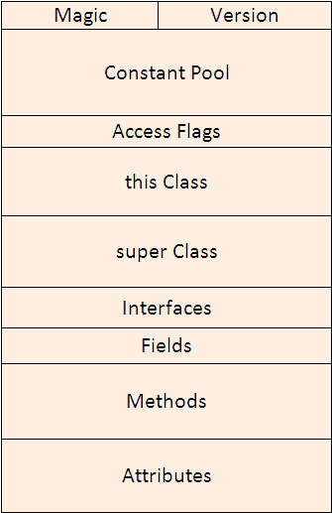
Java .class File Structure
We saw some basic of internals of JVM and how it is divided into different components that helps in execution of Java byte code.
Java Byte code as we saw is packed in a file called class file (with .class extension). In this ppt we will discuss the internals of a class file. How the data is being written in a class file and the class file format.
Let us see first the Diagrammatic representation of a Java Class file.

Slide 7
Java .class File Structure
A Java class file is consist of 10 basic sections:
Magic Number: 0xCAFEBABE
Version of Class File Format: the minor and major versions of the class file
Constant Pool: Pool of constants for the class
Access Flags: for example whether the class is abstract, static, etc.
this Class: The name of the current class
super Class: The name of the super class
interfaces: Any interfaces in the class
Fields: Any fields in the class
Methods: Any methods in the class
Attributes: Any attributes of the class (for example the name of the sourcefile, etc.)
To Remember:
My Very Cute Animal Turns Savage In Full Moon Areas.

Slide 8
Java .class File Structure
The length of the Java class is not known before it gets loaded. There are variable length sections such as constant pool, methods, attributes etc. These sections are organized in such a way that they are prefaced by their size or length. This way JVM knows the size of variable length sections before actually loading them.
The data written in a Class file is kept at one byte aligned and is tightly packed. This helps in making class file compact.
The order of different sections in a Java Class file is strictly defined so that the JVM knows what to expect in a Class file and in which order it is loading different components.

Slide 9
Java .class File Structure
Magic number is used to uniquely identify the format and to distinguish it from other formats. The first four bytes of the Class file are 0xCAFEBABE.

Slide 10
Java .class File Structure
2. Version of Class file
The next four bytes of the class file contains major and minor version numbers. This number allows the JVM to verify and identify the class file. If the number is greater than what JVM can load, the class file will be rejected with the error java.lang.UnsupportedClassVersionError.
You can find class version of any Java class file using javap command line utility. For example:
Consider we have a sample Java class:
javap -verbose MyClass
public class Main { public static void main(String [] args) { int my_integer = 0xFEEDED; } }

Slide 11
Java .class File Structure
2. Version of Class file
We compile this class using javac Main.java command and create class file. Now execute following command to see the major and minor version of class file.
C:\>javap -verbose Main Compiled from "Main.java" public class Main extends java.lang.Object SourceFile: "Main.java" minor version: 0 major version: 50 ...

Slide 12
Java .class File Structure
List of Major versions and corresponding JDK version of class file
Major Version | Hex | JDK version
51 | 0x33 | J2SE 7.0
50 | 0x32 | J2SE 6.0
49 | 0x31 | J2SE 5.0
48 | 0x30 | JDK 1.4
47 | 0x2F | JDK 1.3
46 | 0x2E | JDK 1.2
45 | 0x2D | JDK 1.1

Slide 13
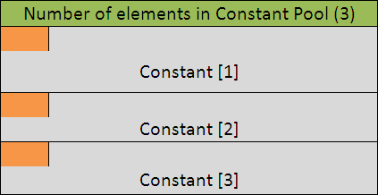
Java .class File Structure
3. Constant Pool
All the constants related to the Class or an Interface will get stored in the Constant Pool. The constants includes class names, variable names, interface names, method names and signature, final variable values, string literals etc.
The constants are stored as a variable length array element in the Constant pool. The arrays of constants are preceded by its array size, hence JVM knows how many constants it will expect while loading the class file. In above diagram, the portion represented in green contains the size of the array.

Slide 14
Java .class File Structure
3. Constant Pool
Within each array elements first byte represents a tag specifying the type of constant at that position in the array.
In below diagram the portion in orange represent the one-byte tag. JVM identifies the type of the constant by reading one-byte tag. Hence if one-byte tag represents a String literal then JVM knows that next 2 bytes represents length of the String literal and rest of the entry is string literal itself.
Java descriptor
Boolean Z
integer I
Object Ljava/lang/Object;
String[] Ljava/lang/String;
int foo(int,Object) (ILjava/lang/Object;)I

Slide 15
Java .class File Structure
3. Constant Pool
We can analyse the Constant Pool of any class file using javap command. Executing javap on above Main class, we get following symbol table.
C:\>javap -verbose Main Compiled from "Main.java" public class Main extends java.lang.Object SourceFile: "Main.java" minor version: 0 major version: 50 Constant pool: const #1 = Method #4.#13; // java/lang/Object."<init>":()V const #2 = int 16707053; const #3 = class #14; // Main const #4 = class #15; // java/lang/Object const #5 = Asciz <init>; const #6 = Asciz ()V;
const #7 = Asciz Code; const #8 = Asciz LineNumberTable; const #9 = Asciz main; const #10 = Asciz ([Ljava/lang/String;)V; const #11 = Asciz SourceFile; const #12 = Asciz Main.java; const #13 = NameAndType #5:#6;// "<init>":()V const #14 = Asciz Main; const #15 = Asciz java/lang/Object;

Slide 16
Java .class File Structure
3. Constant Pool
The constant pool has 15 entries in total. Entry #1 is Method public static void main; #2 is for integer value 0xFEEDED (decimal 16707053). Also we have two entries #3 and #4 which corresponds to this class and super class. Rest is the symbol table storing string literals.
C:\>javap -verbose Main Compiled from "Main.java" public class Main extends java.lang.Object SourceFile: "Main.java" minor version: 0 major version: 50 Constant pool: const #1 = Method #4.#13; // java/lang/Object."<init>":()V const #2 = int 16707053; const #3 = class #14; // Main const #4 = class #15; // java/lang/Object const #5 = Asciz <init>; const #6 = Asciz ()V;
const #7 = Asciz Code; const #8 = Asciz LineNumberTable; const #9 = Asciz main; const #10 = Asciz ([Ljava/lang/String;)V; const #11 = Asciz SourceFile; const #12 = Asciz Main.java; const #13 = NameAndType #5:#6;// "<init>":()V const #14 = Asciz Main; const #15 = Asciz java/lang/Object;

Slide 17
Java .class File Structure
4. Access flags
Access flags follows the Constant Pool. It is a two byte entry that indicates whether the file defines a class or an interface, whether it is public or abstract or final in case it is a class. Below is a list of some of the access flags and their interpretation.
Flag Name | Value | Interpretation
ACC_PUBLIC | 0x0001 | Declared public; may be accessed from outside its package.
ACC_FINAL | 0x0010 | Declared final; no subclasses allowed.
ACC_SUPER | 0x0020 | Treat superclass methods specially when invoked by the invokespecial instruction.
ACC_INTERFACE | 0x0200 | Is an interface, not a class.
ACC_ABSTRACT | 0x0400 | Declared abstract; may not be instantiated.

Slide 18
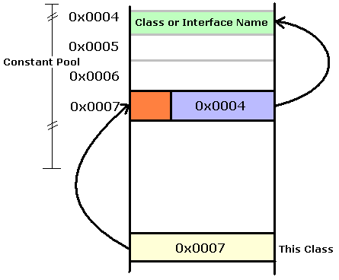
Java .class File Structure
5. this class
This Class is a two byte entry that points to an index in Constant Pool. In the diagram, this class has a value 0x0007 which is an index in Constant Pool.
The corresponding entry that is pointed by this class Constant_pool [this_class] in Constant pool has two parts, first part is the one-byte tag that represents the type of entry in constant pool, in this case it is Class or Interface. In the diagram this is shown in orange color.
And second entry is two-byte having index again in Constant pool. This above diagram, two byte contain value 0x0004. Thus it points to Constant_pool [0x0004] which is the String literal having name of the interface or class.

Slide 19
Java .class File Structure
6. super Class
Next 2 bytes after this Class is of Super Class. Similar to this class, value of two bytes is a pointer that points to Constant pool which has entry for super class of the class.
7. Interfaces
All the interfaces that are implemented by the class (or interface) defined in the file goes in Interface section of a class file. Starting two byte of the Interface section is the count that provides information about total number of interfaces being implemented. Immediately following is an array that contains one index into the constant pool for each interface implemented by class.

Slide 20
Java .class File Structure
8. Fields
A field is an instance or a class level variable (property) of the class or interface. Fields section contains only those fields that are defined by the class or an interface of the file and not those fields which are inherited from the super class or super interface.
First two bytes in Fields section represents count: that is the total number of fields in Fields Section. Following the count is an array of variable length structure one for each field. Each element in this array represent one field. Some information is stored in this structure where as some information like name of the fields are stored in Constant pool.

Slide 21
Java .class File Structure
9. Methods
The Methods component host the methods that are explicitly defined by this class, not any other methods that may be inherited from super class.
First two byte is the count of the number of methods in the class or interface. The rest is again a variable length array which holds each method structure. Method structure contains several pieces of information about the method like method argument list, its return type, the number of stack words required for the method’s local variables, stack words required for method’s operand stack, a table for exceptions, byte code sequence etc.

Slide 22
Java .class File Structure
10. Attributes
Attribute section contains several attribute about the class file, e.g. one of the attribute is the source code attribute which reveals the name of the source file from which this class file was compiled.
First two bytes in Attribute section is count of the number of attributes, followed by the attributes themselves. The JVMs will ignore any attributes they don’t understand.

